Slide 1
Library Management System
Presented by,
V.Suruthika-95072212161
T.Varshitha-95072212167
S.Tamilselvi-95072212164

Slide 2
agenda
INTRODUCTION
TECHNOLOGY
ROLES
PROGRAM
OUTPUT

Slide 3
introduction
A Library Management System (LMS) is a comprehensive software solution designed to automate and streamline library operations.
It is a crucial tool for librarians and library administrators, aiming to enhance the management of library resources and services.
LMS integrates technology into traditional library functions, making tasks more efficient and user-friendly.
Key features of LMS include cataloging, circulation, patron management, and reporting.
It automates various tasks, freeing up librarians to focus on improving services and resources for patrons.
LMS provides patrons with the convenience of easy access to library materials, online searches, and the ability to track their borrowing history.
It enhances the overall efficiency of library services and makes information more accessible.
LMS is vital for libraries to adapt to changing patron needs and stay relevant in the digital age.

Slide 4
Technologies used:
C Programming Language: The core language used for writing the program.
Standard C Libraries: Including <stdio.h> for input/output and <string.h> for string manipulation.
Console Interface: The program runs in a command-line or terminal interface.
Structs: Utilizes a C struct named library to structure book information.
Looping and Control Structures: while loops and switch statements control the program's flow.
Data Input and Output: Uses printf for displaying messages and scanf for user input.
Variables and Data Types: Employs variables of various data types (int, float, char arrays) to store and manage data within the program.
These technologies are fundamental to C programming and are used to create a simple console-based library management system.

Slide 5
ROLES:
Administrator
User

Slide 6
Program:
#include <stdio.h>
#include <string.h>
struct library { char book_name[100];
char author_name[100];
float cost;
int no_of_pages;
int main()
{ struct library lib[100];
int i, j, count; i = 0;
j = 0
count = 0;
while (j != 4) {
printf("\n\n1. Add Book details\n")
printf("2. Display the list of books and its details\n");
printf("3. Display the total number of books in the library\n");
printf("4. Exit\n\n");
printf("Enter the number: ");
scanf("%d", &j);

Slide 7
switch (j) { case 1:
printf("\nYou can add the details of the book\n");
printf("Enter the book name: ");
scanf(" %s", lib[i].book_name);
printf("Enter the author name: ");
scanf(" %s", lib[i].author_name);
printf("Enter the number of pages: ");
scanf("%d", &lib[i].no_of_pages);
printf("Enter the cost of the book: ");
scanf("%f", &lib[i].cost);
count = count + 1;
i = i + 1;
break;
case 2:
if (count == 0)
{
printf("\nThere are no books stored!!\n\n");
}
else {
printf("\nYou can view the list of books\n");
printf("The list of books are:\n");
for (i = 0; i < count; i++)

Slide 8
{
printf("Book Name: %s\n", lib[i].book_name);
printf("Author Name: %s\n", lib[i].author_name);
printf("Number of Pages: %d\n", lib[i].no_of_pages);
printf("Cost of the Book: %.2f\n\n", lib[i].cost);
}
}
break;
case 3:
printf("\nTotal number of books in the library: %d\n\n", count);
break;
case 4:
return 0;
default:
printf("\nInvalid number entered\n\n");
}
}
return 0;
}

Slide 9
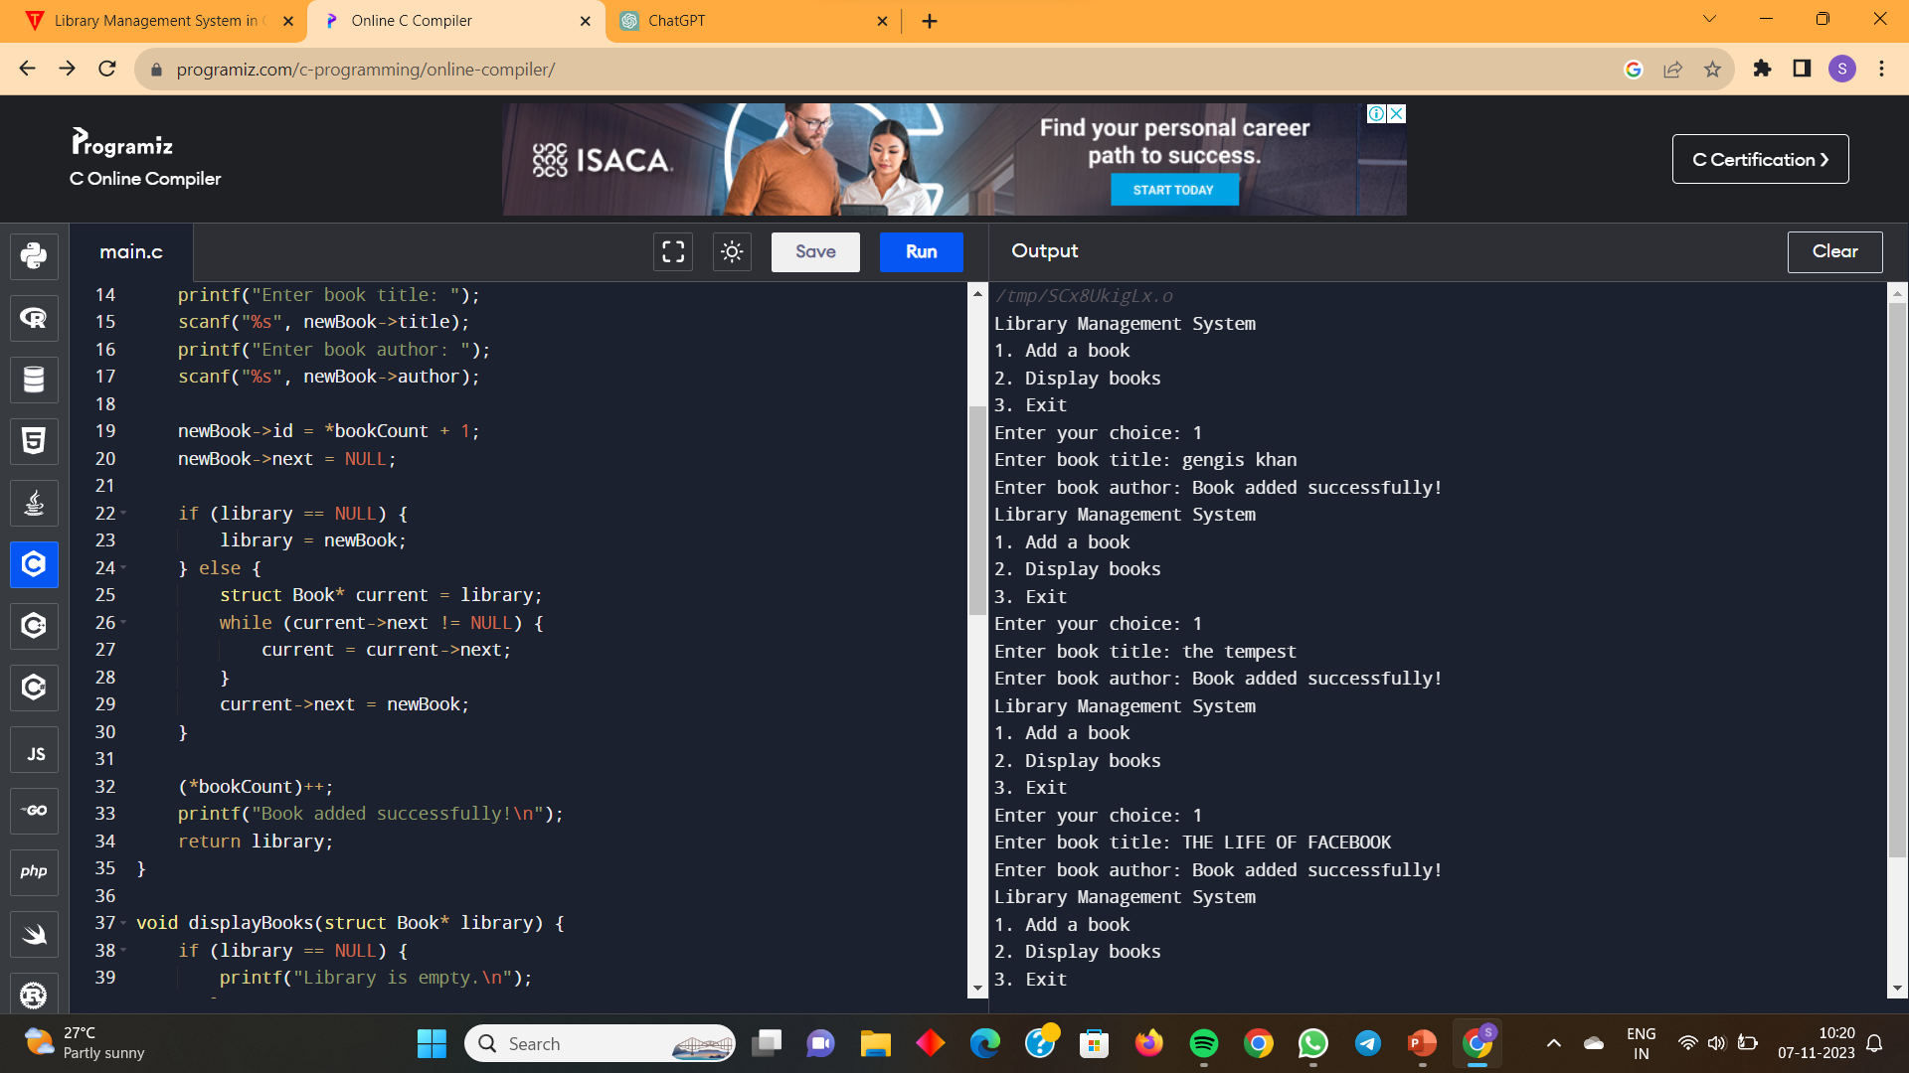
OUTPUT:

Slide 10
thank you

